Slide 1
STAT41130: Class 2 Learning by Hand – Training a Simple Neural Network
Andrew Parnell

Slide 2
Training a Neural Network by Hand
Today's goal: understand how NNs learn.
Walk through forward and backward passes.
Update weights over a few steps (epochs).
Manual learning = strong intuition for automation later.

Slide 3

The Network Structure
Input: $x_{1}, x_{2}, x_{3}$
Hidden: 2 neurons with ReLU activations
Output: 1 neuron with Sigmoid activation
Integer weights and biases for simplicity

Slide 4
Now with weights

Slide 5
Input and Target
One input vector: [1, 0, 1]
Target output (label): 1
This is a classification model
Goal: network output should approach 1 over time
Enables clear step-by-step learning trace

Slide 6
Initialise Weights and Biases
Start with all weights small, but helpful if they’re non-zero
All biases = 0
Will update over training using error signal
Small integers make learning interpretable
Hidden layer weights: W[1] = [[1, -1, 1], [0, 0, 1]]
Hidden biases: b[1] = [0, 0]
Output weights: W[2] = [1, -1], Output bias: b[2] = 0

Slide 7
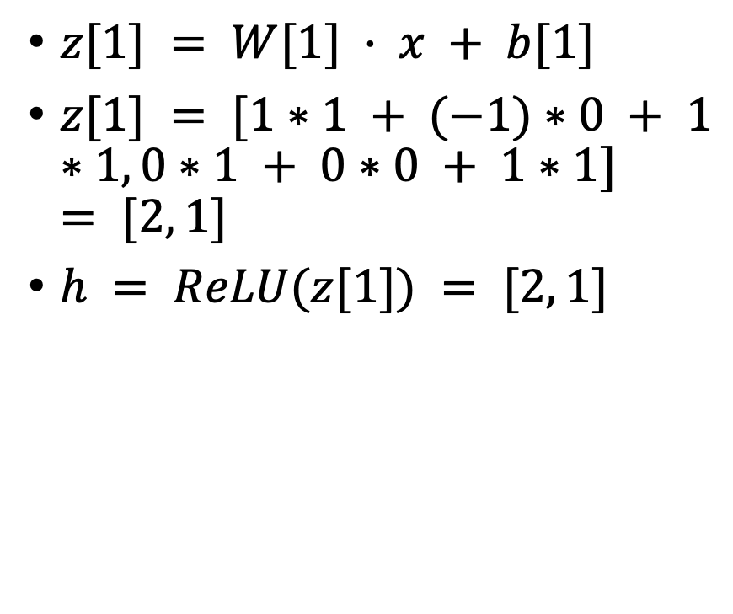
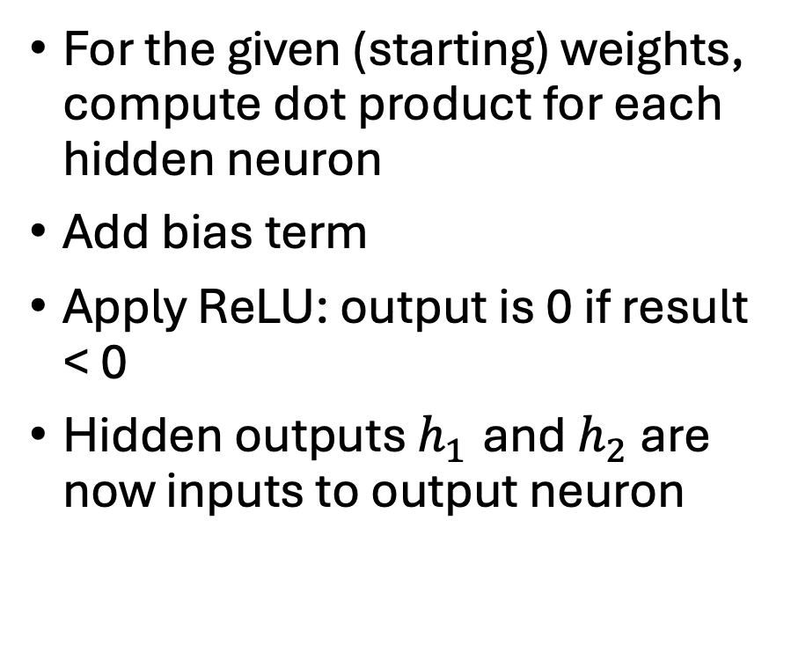
Step 1 – Forward Pass (Hidden Layer)
For the given (starting) weights, compute dot product for each hidden neuron
Add bias term
Apply ReLU: output is 0 if result < 0
Hidden outputs $h_{1}$ and $h_{2}$ are now inputs to output neuron
$z[1] = W[1] · x + b[1]$
$z[1] = [1∗1 + (−1)∗0 + 1∗1, 0∗1 + 0∗0 + 1∗1] = [2, 1]$
$h = ReLU(z[1]) = [2, 1]$

Slide 8

Step 2 – Forward Pass (Output Layer)
z[2] = W[2] · h + b[2] = 1*2 + (-1)*1 + 0 = 1
• ŷ = Sigmoid(z[2]) = 0.5 (quantized: -2 < 1 < 2)
• Prediction: ŷ = 0.5, Target: y = 1
• We are underpredicting; compute loss next
Use hidden outputs to compute output layer input
Compute $z = w · h + b$
Apply Sigmoid activation (quantized 3-level)
Output is 0, 0.5, or 1 depending on z

Slide 9

Step 3 – Compute Loss
Use Binary Cross-Entropy:
$$L = −[y log⁡(\hat{y}) + (1−y) log⁡(1 −\hat{y})]$$
Compare network output to target label
Loss is high if output far from target
Loss tells us how ‘wrong’ the current weights and biases are
L = -[y·log(ŷ) + (1−y)·log(1−ŷ)]
L = -log(0.5) = 0.693
Loss is high → backpropagation needed
We will now update weights

Slide 10
Step 4 – Backpropagation Intuition
Compute error at the output layer.
Adjust output weights to reduce the error.
Propagate error backward to hidden layer.
Weights are updated to reduce future errors.

Slide 11
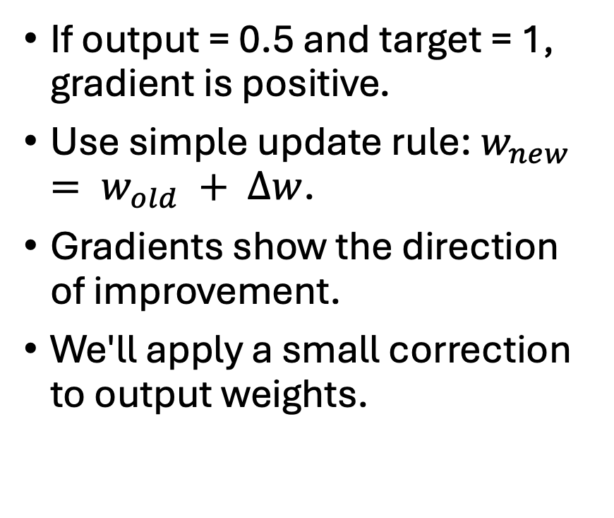
Step 5 – Compute Gradients (Output Layer)
If output = 0.5 and target = 1, gradient is positive.
Use simple update rule: $w_{new} = w_{old} + Δw$.
Gradients show the direction of improvement.
We'll apply a small correction to output weights.
Gradient of loss w.r.t. output: ∂L/∂z₂ = ŷ - y = 0.5 - 1 = -0.5
ΔW[2] = -0.5 * h = [-1.0, -0.5]
Δb[2] = -0.5
Update: W[2] = [1, -1] + [-1.0, -0.5] = [0, -1.5]

Slide 12
Step 6 – Update Output Weights
New weights = old weights + delta (Δw).
Update bias similarly, if used.
Use integer updates to keep it interpretable.
Track changes in a table.
Only neurons with z > 0 propagate error
h = [2, 1] → both ReLU active
Error distributed using output weights
ΔW[1][0] = -0.5 * W[2][0] * ∂ReLU * x = 0 * x = 0 (W[2][0] = 0)
ΔW[1][1] = -0.5 * W[2][1] * x = 0.75 * x = [0.75, 0, 0.75]

Slide 13
Step 7 – Propagate to Hidden Neurons
Hidden neurons are updated only if activated (ReLU > 0).
Distribute 'blame' to contributing neurons.
Use output error to guide input weight changes.
Track contributions through connections.

Slide 14
Step 8 – Update Hidden Weights
Adjust weights of active hidden neurons.
Bias update included with each neuron.
Manual update shows how weights learn to align.
Use visual cues to compare before/after values.
Updated W[1][1] = [0, 0, 1] + [0.75, 0, 0.75] = [0.75, 0, 1.75]
W[2] = [0, -1.5], b[2] = -0.5

Slide 15
Dear Grandmo,
Get Well Soon!
Love from Matthew

Slide 16
Summary of Epoch 1
Forward pass completed with initialized weights.
Loss computed from output prediction.
Backward pass adjusted weights toward target.
Epoch 1 results in noticeable parameter changes.

Slide 17
Epoch 2 – Forward Again
Run forward pass with updated weights.
Compute new hidden activations and output.
Expect output closer to target = 1.
ReLU and Sigmoid continue to shape values.

Slide 18
Epoch 2 – Loss Update
Compare new prediction to target again.
Loss should decrease if learning occurred.
Track how network output improves over time.
Learning = reducing prediction error step-by-step.

Slide 19
Backward – Round 2
Output error is smaller than Epoch 1.
Gradient values become smaller as accuracy increases.
Weights fine-tuned rather than dramatically changed.
Gradual convergence is a good sign.

Slide 20
Hidden Layer Weight Updates (Epoch 2)
Recompute blame to each input weight.
Only update for neurons that were active.
Weight changes are now smaller.
Show differences using before/after table.

Slide 21
Summary of Epoch 2
Output moved closer to 1.
Loss dropped compared to Epoch 1.
Learning rate was effective.
Track all parameter values again.

Slide 22
Overall algorithm
1. Initialize all weights and biases (e.g., to 0 or small integers). 2. For each epoch: a. Forward pass: i. Compute hidden layer pre-activations: z₁ = w₁·x + b₁, z₂ = w₂·x + b₂ ii. Apply ReLU activation: h₁ = ReLU(z₁), h₂ = ReLU(z₂) iii. Compute output layer input: zₒ = wₒ·h + bₒ iv. Apply Sigmoid activation to get prediction: ŷ = σ(zₒ) b. Compute Loss: i. Use Binary Cross-Entropy: L = -[y·log(ŷ) + (1−y)·log(1−ŷ)] c. Backward pass: i. Compute gradient of loss with respect to output weights ii. Backpropagate error to hidden weights only if ReLU > 0 d. Update parameters: i. Adjust weights and biases with gradient steps ii. Repeat for desired number of epochs

Slide 23
Compare Epochs – Learning Trace
Usually we display outputs of loss function over epochs
Can also show weight evolution side-by-side.
Biggest changes usually in early epochs.
Later epochs just refine the pattern.

Slide 24

Summary – What the Network Learned
Hidden neuron 1 became active for [1,0,1].
Its weights increased to drive output up.
Output weights were tuned to emphasize $h_{1}$.
Biases adjusted to support activation.

Slide 25
Key Concepts Reviewed
Forward pass: dot product + bias + activation.
Loss function measures prediction error.
Backprop distributes error and adjusts weights.
Learning = doing this over and over (epochs).

Slide 26
Common Mistakes (By Hand and Code)
Forgetting to apply bias before activation.
Mislabeling the sign of gradient updates.
Applying activation at wrong stage.
ReLU 'zero-out' not handled correctly.

Slide 27
Practice Suggestions
Change input: try [0,1,1] or [1,1,1].
Try other initial weights and compare convergence.
Use two training examples: see interference.
Try tanh activation instead of ReLU.
A similar version to this will be Q1 of the exam.

Slide 28
Wrap-Up and Preview of Day 1
You built and trained a neural net by hand!
Next step: implement this in code (Python).
We’ll explore batch training and loss curves.
Get ready for coding labs and deeper models.

